Slide 1
Developing Advanced Reports

Slide 2
Speaking in Code
One of the features of Reporting Services that gives it a tremendous amount of power and flexibility is its capability to speak in code - Visual Basic .NET code, that is.
Valid Visual Basic .NET expressions can be used to control many of the properties of report items. They can even be used to control the query you are using to create your dataset.
For more complex tasks, you can embed whole Visual Basic .NET functions in your report. If that isn’t enough, you can access methods from .NET assemblies.
These assemblies are not limited to Visual Basic .NET. They can be written in any .NET language, such as C#.

Slide 3
The Delivery Status Report
Features Highlighted
Using the label property of a parameter
Using multiline headers and footers
Using Visual Basic .NET expressions to control properties
Specifying scope in aggregate functions
Business Need - The customer service department at Galactic Delivery Services (GDS) would like a report to check on the status of deliveries for a customer. The customer service representative should be able to select a customer and a year, and then see all the deliveries for that customer in that year. The hubs each package went through as it was in transit should be listed. The status for packages that have been delivered should show up in green. The status for packages still en route should be blue. The status for packages that have been lost should be red. In case of a problem, the name and email address of the person to be contacted at that customer site should appear below the entry for each lost package.
Task Overview
Create a New Report and Two Datasets.
Set Up the Report Parameters and Place the Titles on the Report Layout.
Add a Tablix to the Report.
Add the Expressions.

Slide 4
Exercise 1
Delivery Status Report, Task 1: Create a New Report and Two Datasets
Create a new Reporting Services project called Chapter09 in the MSSQLRS folder.
Create a shared data source called Galactic for the Galactic database.
Create a new report called DeliveryStatus using the GDSReport template.
Create a new data source called Galactic that references the Galactic shared data source.
Create a new dataset called DeliveryStatus that calls the stp_DeliveryStatus stored procedure.
Create a second dataset called Customers that uses the following query:
SELECT CustomerNumber, Name FROM Customer ORDER BY Name

Slide 5
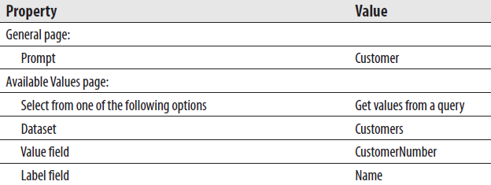
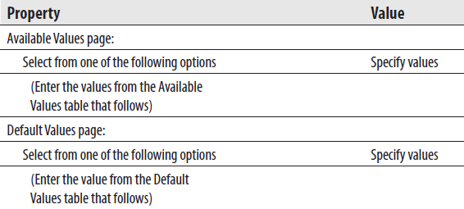
Exercise 1
Delivery Status Report, Task 2: Set Up the Report Parameters and Place the Titles on the Report Layout
The stored procedure triggered the creation of two report parameters. Use the Report Data window to configure the properties of the CustomerNumber parameter as follows:
Click OK to exit the Report Parameters dialog box.
Use the Report Data window to configure the properties of the Year parameter as follows:

Slide 6
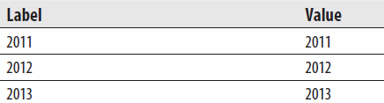

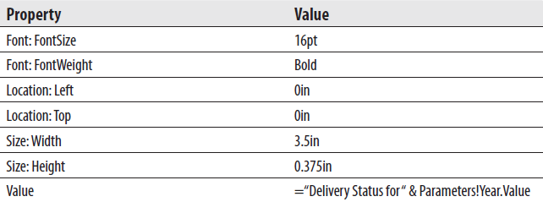
Exercise 1
Delivery Status Report, Task 2: Set Up the Report Parameters and Place the Titles on the Report Layout
On the Available Values page, add the following rows to the grid at the bottom of the dialog box:
On the Default Values page, add the following row to the grid at the bottom of the dialog box:
Click OK to exit the Report Parameters dialog box.
Place a text box onto the body of the report. Modify the following properties of this text box:

Slide 7
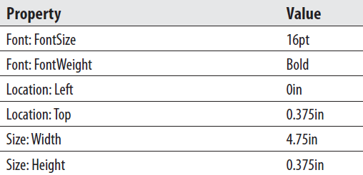
Exercise 1
Delivery Status Report, Task 2: Set Up the Report Parameters and Place the Titles on the Report Layout
Place a second text box onto the body of the report. Modify the following properties of this text box:
Right-click this text box and select Expression from the context menu. The Expression dialog box appears.
Select Parameters in the Category pane and double-click CustomerNumber in the Parameter pane.
Use the backspace key to remove the word “Value” at the end of the expression. (Do not delete the period.) You see a context menu showing you the available properties of the CustomerNumber parameter.
Double-click Label in the context menu.
Click OK to exit the Expression dialog box.

Slide 8

Exercise 1
Delivery Status Report, Task 3: Add a Tablix to the Report
Use the table template to add a tablix to the body of the report immediately below the text boxes.
In the leftmost cell in the data row of the tablix, select the Hub field from the DeliveryStatus dataset.
In each of the two remaining cells in the data row of the tablix, select the TimeIn and TimeOut fields.
Right-click anywhere in the data row and select Tablix: Add Group | Row Group: Parent Group from the context menu. The Tablix group dialog box appears.
Select [DeliveryNumber] from the Group by drop-down list. We are now grouping the information in the table by the values in the DeliveryNumber field.
Check the Add group header and Add group footer check boxes.
Click OK to exit the Tablix group dialog box.
A group header cell is added along the left side of the tablix. This cell contains a text box, which, in turn, contains the DeliveryNumber field. Modify the following properties of the text box containing the DeliveryNumber field:

Slide 9
Exercise 1
Delivery Status Report, Task 3: Add a Tablix to the Report
We need to move some of the labels in the table header row to the group header row. Select the text box that contains the word “Hub”. Do this by clicking once in this text box. If you can see a text-editing cursor blinking in this cell, you clicked too many times. If you see the blinking cursor, click elsewhere, and then try again.
Press ctrl-x to cut the text box from this table header cell. Click in the group header cell immediately below it and press ctrl-v to paste the text box there.
Repeat this for the text boxes containing Time In and Time Out.
Right-click the gray square to the left of the table header row. (This row now only contains the text “Delivery Number.” Only “Delivery” may be showing if the column is too narrow for the entire header text.). Select Delete Rows from the context menu. This removes the table header row from this table.
Right-click anywhere in the group header row and select Tablix: Insert Row | Inside Group - Above from the context menu. An additional group header row appears. This is not a new grouping, but rather, an additional row for the current grouping.
Select the ServiceType field in the leftmost cell in the new group header row.
Select the StatusName field in the next cell in the new group header row.

Slide 10
Exercise 1
Delivery Status Report, Task 3: Add a Tablix to the Report
Right-click anywhere in the new group header row and select Tablix: Insert Row | Inside Group - Above from the context menu. Another new group header row appears.
Double-click the leftmost cell in the new group header row and type Pickup:.
Select the PickupPlanet field in the next cell to the right in the new group header row.
Select the PickupDateTime field in the rightmost cell in the new group header row.
Double-click in the group footer cell below the [Hub] field and type Delivery:.
Select the DeliveryPlanet field in the next cell to the right in the group footer row.
Select the DeliveryDateTime field in the rightmost cell in the group footer row.
Right-click anywhere in the group footer row and select Tablix: Insert Row | Inside Group - Below from the context menu. A new group footer row appears.
Double-click in the group footer cell below Delivery and type Problem Contact:.
Select the ProblemContact field in the next cell to the right in the new group footer row.

Slide 11

Exercise 1
Delivery Status Report, Task 3: Add a Tablix to the Report
Select the ProblemEMail field in the rightmost cell in the new group footer row.
Right-click anywhere in the new group footer row and select Tablix: Insert Row | Inside Group - Below from the context menu. A new group footer row appears. This row is left blank.
Click in the leftmost cell of the top group header row and hold down the mouse button. Drag the mouse to the rightmost cell of the bottom group header row and release the mouse button. You have selected the nine cells in the three group header rows.
Modify the following property for these cells:
Repeat Steps 28 and 29 for the six cells in the two group footer rows.
Click in the cell containing the [DeliveryNumber] field. Hold down the shift key and click the cell in the lower-right corner of the tablix. You have selected all of the cells in the tablix.

Slide 12

Exercise 1
Delivery Status Report, Task 3: Add a Tablix to the Report
Modify the following properties for these cells:
Click the gray box in the upper-left corner of the tablix to select the entire tablix. Use the sizing handle on the right side of the tablix to make it as wide as the design surface.
Click the Preview tab. Select Bolimite, Mfg from the Customer drop-down list. Select 2012 from the Year drop-down list. (The year 2012 is already selected for you because you set it up as the default value for the Year parameter.) Click View Report.
You may want to return to the Design tab and adjust the size of some of the columns so the data does not wrap within text boxes.

Slide 13
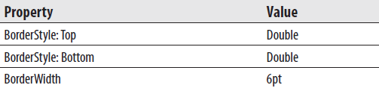
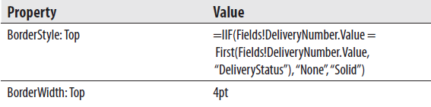
Exercise 1
Delivery Status Report, Task 4: Add the Expressions
Click the Design tab.
Select the entire tablix, if it is not selected already. Modify the following properties of the tablix:
Enter the following expression for the Color property of the cell containing the StatusName field:
= IIF(Fields!StatusName.Value = "Delivered", "Green",
IIF(Fields!StatusName.Value = "In Route", "Blue", "Red"))
Click the gray square to the left of the top group header row so the entire row is selected. Modify the following properties for these cells:

Slide 14

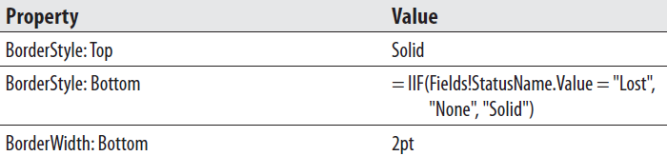
Exercise 1
Delivery Status Report, Task 4: Add the Expressions
Click and hold down the left mouse button in the cell containing the word “Hub.” Continue to hold down the left mouse button and drag the cursor through the Time In cell to the Time Out cell. All three cells should now be selected. Modify the following property for these cells:
Select the following three cells using the same method as in Step 5: “Delivery:”, “[DeliveryPlanet]”, “[DeliveryDateTime]”. Modify the following properties for these cells:

Slide 15
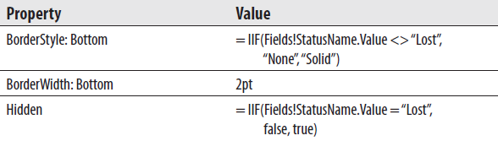
Exercise 1
Delivery Status Report, Task 4: Add the Expressions
Select the following three cells: “Problem Contact:”, “[ProblemContact]”, “[ProblemEmail]”. Modify the following properties for these cells:
Click the Preview tab. Select Bolimite, Mfg from the Customer drop-down list and 2012 from the Year drop-down list, if they are not already selected. Click View Report.
Select Save All on the toolbar.

Slide 16
The Lost Delivery Report
Features Highlighted
Using Visual Basic .NET expressions to calculate values in a text box
Adding static columns to a tablix functioning as a matrix
Adding totals to a tablix functioning as a matrix
Business Need - The quality assurance department at Galactic Delivery Services would like a report to help them analyze the packages lost during delivery. The report should show the number of packages lost each year at each processing hub. It should break down these numbers by the cause for each loss. It should also show the number of losses by cause as a percentage of the total number of packages lost for each hub.
Task Overview
Create a New Report, Create a Dataset, and Add a Tablix to the Report.
Add a Calculated Column to the Tablix.
Add an Indicator and Totals to the Tablix.

Slide 17
Exercise 2
Lost Delivery Report, Task 1: Create a New Report, Create a Dataset, and Add a Tablix to the Report
Reopen the Chapter09 project, if it was closed.
Create a new report called LostDelivery using the GDSReport template.
Create a new data source called Galactic that references the Galactic shared data source.
Create a new dataset called LostDelivery that calls the stp_LostDeliveries stored procedure.
Use the matrix template to place a tablix onto the body of the report.
Select the Cause field in the Rows cell. Select the Hub field in the Columns cell.
Select the DeliveryNumber field in the Data cell. Use the Expression dialog box to edit the aggregate function in the resulting expression by changing it from Sum to Count.
Click in the upper-left cell of the tablix. Hold down the shift key and click the lower-right cell. All four cells in the tablix should be selected.

Slide 18

Exercise 2
Lost Delivery Report, Task 1: Create a New Report, Create a Dataset, and Add a Tablix to the Report
Modify the following properties of the selected cells:
Click outside of the tablix to unselect the cells.
Right-click the Hub cell and select Tablix: Add Group | Column Group | Parent Group. The Tablix group dialog box appears.
Click the Expression (fx) button. The Expression dialog box appears.
Type the following in the Set expression for: GroupExpression area to group the values by year:
=Year(Fields!PickupDateTime.Value)
Click OK to exit the Expression dialog box.
Click OK to exit the Tablix group dialog box.
Select the empty cell in the upper-left corner of the tablix. Hold down the shift key and click the cell immediately below it. Right-click in this same cell and select Tablix: Merge Cells from the context menu.

Slide 19
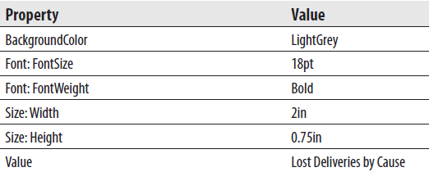

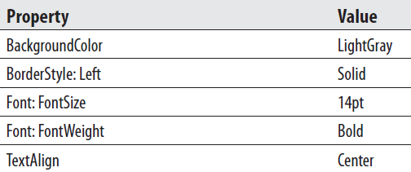
Exercise 2
Lost Delivery Report, Task 1: Create a New Report, Create a Dataset, and Add a Tablix to the Report
Modify the following properties of the text box in the merged cell you just created:
Modify the following property of the text box in the lower-left corner of the tablix:
Modify the following properties of the text box in the upper-right corner of the tablix:

Slide 20
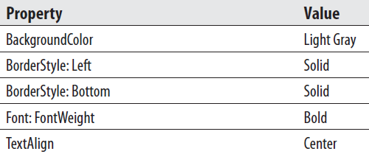

Exercise 2
Lost Delivery Report, Task 1: Create a New Report, Create a Dataset, and Add a Tablix to the Report
Modify the following properties of the text box in the center of the right-hand column of the tablix:
Modify the following property of the text box in the lower-right corner of the matrix:

Slide 21
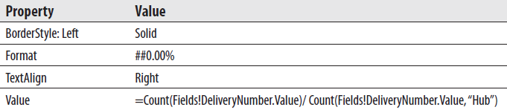
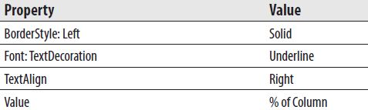
Exercise 2
Lost Delivery Report, Task 2: Add a Calculated Column to the Tablix
Right-click the text box in the lower-right corner of the matrix and select Tablix: Insert Column | Inside Group - Right from the context menu. A new column is created inside of the Hub group.
Right-click the same text box and select Tablix: Insert Row | Outside Group - Above from the context menu. A new row appears above the Cause group.
Modify the following properties of the new text box in the lower-right corner of the tablix:
Modify the following properties of the text box immediately above the text box modified in Step 3:

Slide 22
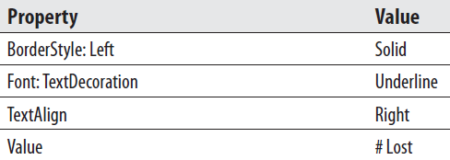
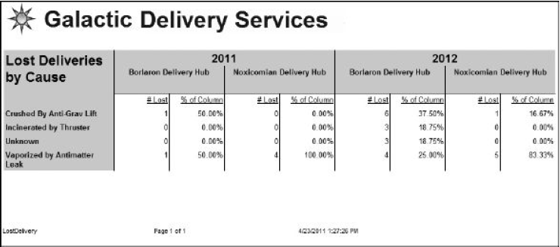
Exercise 2
Lost Delivery Report, Task 2: Add a Calculated Column to the Tablix
Modify the following properties of the text box immediately to the left of the text box modified in Step 4:
Click the Preview tab. The report should appear similar to figure below.

Slide 23
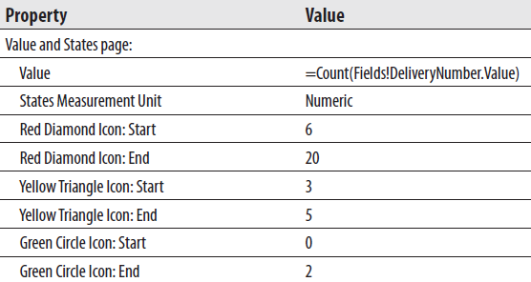
Exercise 2
Lost Delivery Report, Task 3: Add an Indicator and Totals to the Tablix
Return to Design mode.
Right-click the text box containing “# Lost” and select Tablix: Insert Column | Inside Group – Right.
Select an Indicator from the Toolbox or Insert tab and place it in the lower of the two new cells you just created.
The Select Indicator Type dialog box appears.
Select “3 Signs” as shown in figure on next slide.
Click OK to exit the Select Indicator Type dialog box.
Modify the following properties of the indicator you just created using the Indicator Properties dialog box:

Slide 24
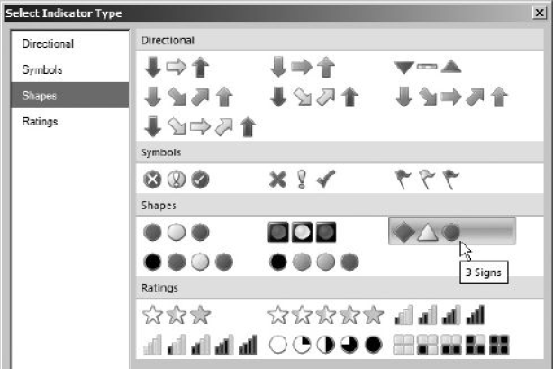

Exercise 2
Lost Delivery Report, Task 3: Add Totals to the Tablix
Narrow the column containing the indicator so it is just wide enough for the indictor itself.
Right-click the text box in the lower-left corner of the matrix, and select Tablix: Add Total | After from the context menu. A total row is added at the bottom of the tablix.
Modify the following properties of the text box containing the word “Total”:

Slide 25

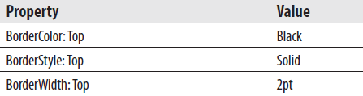

Exercise 2
Lost Delivery Report, Task 3: Add Totals to the Tablix
Modify the following properties of the text box at the bottom of the column containing “# Lost”:
Modify the following properties of the text box at the bottom of the column containing the indicator:
Modify the following properties of the text box at the bottom of the column containing “% of Column”:
Right-click the text box in the upper-right corner of the matrix. Select Tablix: Add Total | After from the context menu. A set of three columns is added at the right of the tablix.

Slide 26
Exercise 2
Lost Delivery Report, Task 3: Add Totals to the Tablix
Right-click the gray rectangle above the middle of the three new columns. Select Delete Columns from the context menu.
Right-click the cell in the lower-right corner of the tablix. Select Expression from the context menu. The Expression dialog box appears.
Modify the expression to match the following:
=Count(Fields!DeliveryNumber.Value)/ Count(Fields!DeliveryNumber.Value, "LostDelivery")
The change is the scope parameter in the second Count() aggregate function.
Click OK to exit the Expression dialog box.
Right-click the cell immediately above the cell you modified in Steps 16–18. Select Expression from the context menu. The Expression dialog box appears.
Modify the expression to match the following:
=Count(Fields!DeliveryNumber.Value)/ Count(Fields!DeliveryNumber.Value, "LostDelivery")
The change is the scope parameter in the second Count() aggregate function.

Slide 27
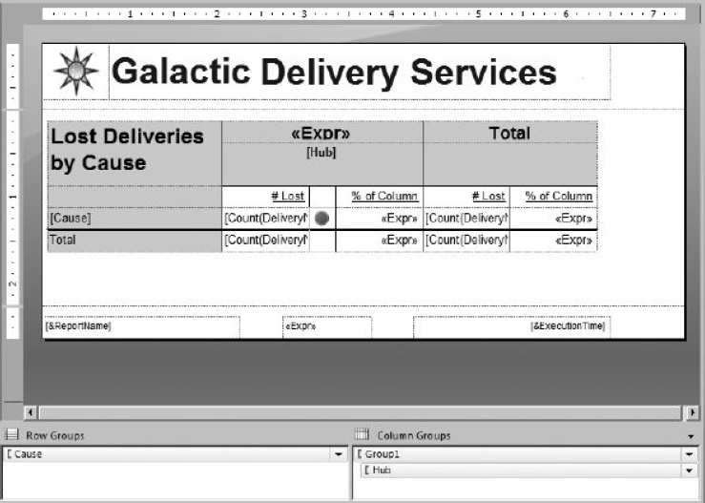
Exercise 2
Lost Delivery Report, Task 3: Add Totals to the Tablix
Click OK to exit the Expression dialog box
Enter % of Column in the text box immediately above the text box you modified in Steps 19–21.
Enter # Lost in the text box to the left of the text box you modified in Step 22.
When completed, your report layout should appear similar to figure below.
Preview/Run the report.
Save the report.

Slide 28
The Customer List Report - Revisited
Features Highlighted
Copying a report between projects
Using Visual Basic .NET expressions to specify a dataset query
Business Need - The Customer List Report we developed for the Galactic Delivery Services accounting department has proved to be popular. Several other departments would like similar reports to help them track their own lists of email contacts. Rather than create separate reports for each department, which would be hard to maintain, the IT manager has asked for one report that enables the user to select which type of contact they want to view.
Task Overview
Copy the Report from the Chapter04 Project and Add It to the Chapter09 Project.
Add a Report Parameter and Modify the Dataset to Use the Report Parameter.

Slide 29
Exercise 3
Customer List Report - Revisited, Task 1: Copy the Report from the Chapter04 Project and Add It to the Chapter08 Project
Use Windows Explorer to copy the report definition file for the Customer List Report (Customer List.rdl) from the Chapter04 project folder and paste it in the Chapter09 project folder. Both of these folders should be found under My Documents in the Visual Studio 2010\Projects\MSSQLRS folder.
In Report Designer, reopen the Chapter09 project, if it was closed.
Right-click the Reports folder in the Solution Explorer and select Add | Existing Item from the context menu. The Add Existing Item - Chapter09 dialog box appears.
Make sure you are looking at the Chapter09 folder in the dialog box and select the Customer List.rdl file. Click Add to exit the Add Existing Item - Chapter08 dialog box.
Double-click the Customer List.rdl entry in the Solution Explorer to open the report definition.
Click the Preview tab to show this report is functioning properly in the Chapter08 project.

Slide 30
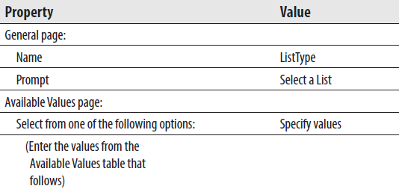
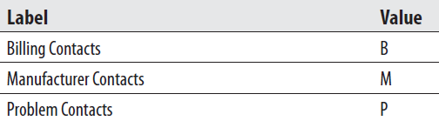
Exercise 3
Customer List Report—Revisited, Task 2: Add a Report Parameter and Modify the Dataset to Use the Report Parameter
Click the Design tab.
Right-click the Parameters item in the Report Data window. Select Add Parameter from the context menu. The Report Parameter Properties dialog box appears.
Modify the properties for this new report parameter as follows:
On the Available Values page, add the following rows to the grid at the bottom of the dialog box:

Slide 31
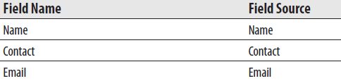
Exercise 3
Customer List Report—Revisited, Task 2: Add a Report Parameter and Modify the Dataset to Use the Report Parameter
Click OK to exit the Report Parameter Properties dialog box.
In the Report Data window, right-click the entry for DataSet1 and select Dataset Properties from the context menu. The Dataset Properties dialog box appears.
Click the Expression (fx) button next to the Query area. The Expression dialog box appears.
Replace the entire select statement with the following expression:
=IIF(Parameters!ListType.Value="B",
"EXEC stp_BillingContacts",
IIF(Parameters!ListType.Value="M",
"EXEC stp_ManufacturerContacts",
"EXEC stp_ProblemContacts"))
Click OK to exit the Expression dialog box.
Select the Fields page.
Change the table on the Fields page to match the following:

Slide 32
Exercise 3
Customer List Report—Revisited, Task 2: Add a Report Parameter and Modify the Dataset to Use the Report Parameter
Click OK to exit the Dataset Properties dialog box.
In the text box that currently says “[BillingContact],” select the Contact field using the Field Selector.
Double-click the table header cell directly above the text box from Step 12 and change the text to Contact.
In the text box that currently says “[BillingEmail],” select the Email field using the Field Selector.
Double-click the table header cell directly above the text box from Step 14 and change the text to Email.
Save the report.
Preview/Run the report. Try selecting each of the list types. Remember to click View Report each time after changing your parameter selection.

Slide 33
The Delivery Trend Report
Features Highlighted
Using the Sparkline report item
Business Need - The marketing department at Galactic Delivery Services would like a compact report showing customer delivery trends. The report should show the total number of deliveries for each customer along with a chart showing deliveries by month for each customer. The report should be as small as possible so it can be used as part of a company intranet page.
Task Overview
1. Create a New Report, Create a Dataset, and Create a Report Layout

Slide 34
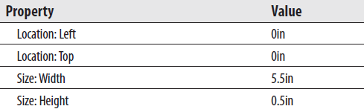
Exercise 4
Delivery Trend Report, Task 1: Create a New Report, Create a Dataset, and Create a Report Layout
Create a new report called DeliveryTrend. Do not use the GDSReport template.
Create a new data source called Galactic that references the Galactic shared data source.
Create a new dataset called DeliveryTrend that calls the stp_DeliveryTrend stored procedure.
Use the table template to place a tablix onto the body of the report.
Modify the following properties of the tablix in the Properties window:
Change the size of the report body so it is the same size as the tablix.
Select the Name field in the left-hand Data cell.

Slide 35
Exercise 4
Delivery Trend Report, Task 1: Create a New Report, Create a Dataset, and Create a Report Layout
Use the Details drop-down button in the Row Groups area to select Group Properties. The Group Properties dialog box appears.
Click the Add button in the Group Expressions area.
Select Name from the Group on drop-down list.
Click OK to exit the Group Properties dialog box.
Select the DeliveryCount field in the center Data cell.
Change the heading for this center column to Total Deliveries.
Place a sparkline in the right-hand data cell. The Select Sparkline Type dialog box appears.
Select Area as shown in Figure 9-9.
Click OK to exit the Select Sparkline Type dialog box.
Click the sparkline item to activate the Chart Data window.
Click the green plus sign next to the Values area, and select DeliveryCount.
Click the green plus sign next to the Category Groups area, and select YearMonth.

Slide 36


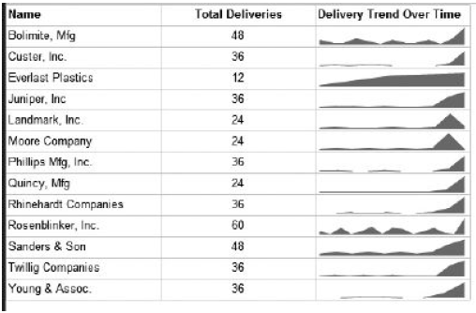
Exercise 4
Delivery Trend Report, Task 1: Create a New Report, Create a Dataset, and Create a Report Layout
Enter Delivery Trend Over Time in the text box above the sparkline.
Click the gray rectangle to the left of the tablix header row.
Modify the following property in the Properties window:
Select the gray rectangle above the center column.
Modify the following property in the Properties window:
Preview/Run the report. Your
report will appear similar to
the figure on the right.
Save the report.

Slide 37
Payroll Checks
Features Highlighted
Using Visual Basic .NET functions embedded in the report to create reusable code
Using a stored procedure that updates data
Grouping in the details row of a data region
Using nested data regions
Resetting the page number
Business Need - The Galactic Delivery Services accounting department needs a report to print payroll checks for its hourly employees. The checks should have the check portion in the top one-third of the page and the check register in the bottom two-thirds of the page. The check register should list the work hours included in this check. The user should be able to select a week for which unpaid time is entered and receive the payroll checks for that week. The planetary system tax amount (25 percent) and state tax amount (5 percent) must be deducted from the amount being paid.
Task Overview
Create a New Report, Create Two Datasets, Add a Tablix to the Report Layout, and Populate It.
Add a Second Tablix to the Report Layout and Populate It.
Configure the Report Parameter and Add Embedded Code to the Report.

Slide 38
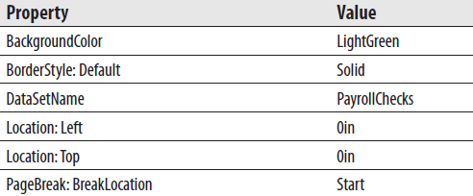
Exercise 4
Payroll Checks, Task 1: Create a New Report, Create Two Datasets, Add a Tablix to the Report Layout, and Populate It
Reopen the Chapter08 project, if it was closed.
Create a new report called PayrollChecks. Do not use the GDSReport template.
Create a new data source called Galactic that references the Galactic shared data source.
Create a new dataset called PayrollChecks that calls the stp_PayrollChecks stored procedure.
Create a new dataset called WeekNumbers that calls the stp_WeekNumbers stored procedure.
Use the list template to place a tablix onto the body of the report. Modify the following properties of this tablix in the Properties window:

Slide 39
Exercise 4
Payroll Checks, Task 1: Create a New Report, Create Two Datasets, Add a Tablix to the Report Layout, and Populate It
In the Row Group pane, select Group Properties from the (Details) drop-down menu. The Group Properties dialog box appears.
On the General page, click Add to add an item to the group expression.
Select [PayrollCheckNumber] from the Group on drop-down list.
Click OK to exit the Group Properties dialog box.
Add text boxes to the list to get the layout shown in figure. Make sure the list is selected each time before you drag a field or text box onto it. Remember, the square brackets around an item indicate that a field is being displayed in that text box. Enlarge the report body and the tablix, if necessary.

Slide 40
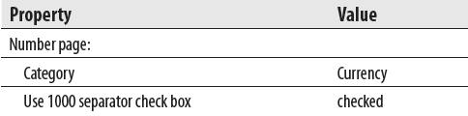
Exercise 4
Payroll Checks, Task 1: Create a New Report, Create Two Datasets, Add a Tablix to the Report Layout, and Populate It
Click the text box containing the PayrollCheckNumber field to select it. Rightclick the text box and select Expression from the context menu. The Expression dialog box appears.
Remove the Sum() aggregate function so the expression is as follows:
=Fields!PayrollCheckNumber.Value
Click OK to exit the Expression dialog box.
Right-click the text box containing the LineAmount field and select Textbox Properties from the context menu. The Text Box Properties dialog box appears.
Modify the following properties of this text box:
Click OK to exit the Text Box Properties dialog box.

Slide 41
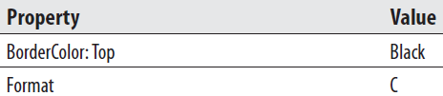
Exercise 4
Payroll Checks, Task 2: Add a Second Tablix to the Report Layout and Populate It
Increase the height of the report body and the tablix. For the remainder of the report, we will refer to this tablix as the “list tablix.”
Use the table template to place a tablix inside the list tablix. The new tablix should be below the signature text box. We will refer to this new tablix as the “table tablix.”
Make the table tablix almost as wide as the list tablix.
Select the WorkDate, HoursWorked, and LineAmount fields in the cells in the data row of the table tablix.
Right-click anywhere in the lower row of the table tablix and select Tablix: Insert Row | Outside Group - Below from the context menu. This new row will serve as a total row.
Select the LineAmount field in the rightmost cell of the row we just added to the table tablix. Set the following properties for the text box in this cell:

Slide 42

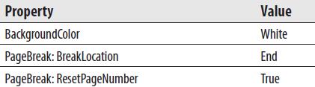
Exercise 4
Payroll Checks, Task 2: Add a Second Tablix to the Report Layout and Populate It
Set the following property for the text box in the cell immediately above the cell modified in Step 6:
Set the following properties for the table tablix:
Drag the bottom of the list tablix and the bottom of the report body up so they are the same as the bottom of the table tablix.
Right-click anywhere outside the report body but inside the design area. Select Add Page Footer from the context menu.
Place a text box in the center of the page footer.
Right-click the text box and select Expression from the context menu. The Expression text box appears.

Slide 43
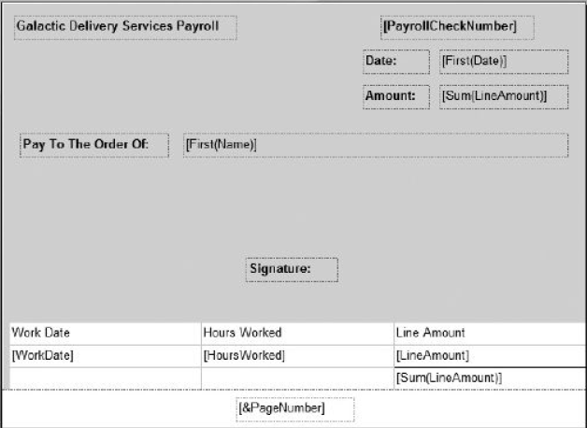
Exercise 4
Payroll Checks, Task 2: Add a Second Tablix to the Report Layout and Populate It
Select Built-in Fields in the Category area.
Double-click Page Number.
Click OK to exit the Expression dialog box.
Your report layout appears similar to figure below.

Slide 44
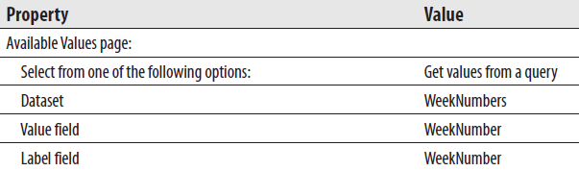
Exercise 4
Payroll Checks, Task 3: Configure the Report Parameter and Add Embedded Code to the Report
Expand the Parameters entry in the Report Data window.
Right-click the WeekNumber entry and select Parameter Properties from the context menu. The Report Parameter Properties dialog box appears.
Modify the following properties for the WeekNumber parameter:
Click OK to exit the Report Parameter Properties dialog box.
Right-click anywhere on the report layout to activate the Report menu. Select Report | Report Properties to open the Report Properties dialog box.
Select the Code page.
Enter the following in the Custom code area:
' State and Planetary System Tax Deductions
Public Function TaxDeductions(ByVal Amount As Double) As Double
' Planetary System Tax = 25%
' State Tax = 5%
TaxDeductions = Amount * .25 + Amount * .05
End Function

Slide 45
Exercise 4
Payroll Checks, Task 3: Configure the Report Parameter and Add Embedded Code to the Report
Click OK to exit the Report Properties dialog box.
Right-click the text box in the list tablix (but not in the table tablix) containing the [Sum(LineAmount)] value and select Expression from the context menu. The Expression dialog box appears.
Replace the contents of the Set expression for: Value area with the following:
=Sum(Fields!LineAmount.Value) -
Code.TaxDeductions(Sum(Fields!LineAmount.Value))
Ignore the red line under “TaxDeductions” indicating a syntax error.
Click OK to exit the Expression dialog box.
Repeat Steps 10 through 12, with the text box in the table tablix containing the sum of the LineAmount values.
Right-click the text box in the details row of the table tablix containing the LineAmount field and select Expression from the context menu. The Expression dialog box appears.
Replace the contents of the Set expression for: Value area with the following:
=Fields!LineAmount.Value - Code.TaxDeductions(Fields!LineAmount.Value)

Slide 46
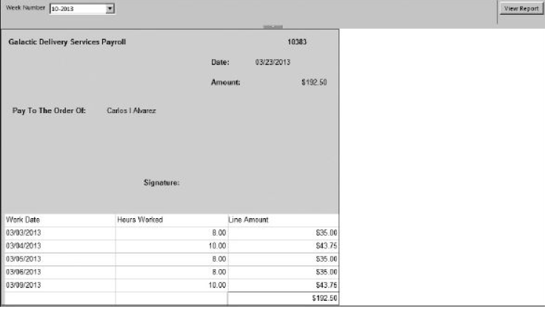
Exercise 4
Payroll Checks, Task 3: Configure the Report Parameter and Add Embedded Code to the Report
Click OK to exit the Expression dialog box.
Click the Preview tab.
Select 10-2013 from the Week Number drop-down list and click View Report. Your report should appear similar to figure below. Remember, once checks have been run for a given week, you cannot produce checks for that week again. Each time you enter the report, the Week Number drop-down list only contains entries for weeks that have not been run.
Save the report.

Slide 47
The Weather Report
Features Highlighted
Referencing .NET assemblies in the report
Using a multivalued parameter
Business Need - The Galactic Delivery Services flight control department needs a way to quickly list the current weather conditions at selected planets served by GDS. (After all, space transports have to go through the atmosphere to take off and land.) One of the GDS programmers has created a .NET assembly that uses a web service to get the weather from various locations. The user should be able to select one or more planets from a list and see the weather for all selected planets. A call must be made to a method of the .NET assembly for each of the selected planets and the results must be incorporated into the report.
Task Overview
Copy the .NET Assembly into the Appropriate Location, Create a New Report, and Create a Reference to the Assembly.
Create a Dataset, Add a Tablix to the Report Layout, and Populate It.

Slide 48
Exercise 5
Weather Report, Task 1: Copy the .NET Assembly into the Appropriate Location, Create a New Report, and Create a Reference to the Assembly
If you have not already done so, download the WeatherInfo.dll assembly from the website for this book.
Copy this file to the Report Designer folder. The default path for the Report Designer folder is
C:\Program Files\Microsoft Visual Studio 10.0\ Common7\IDE\PublicAssemblies
We need to make some additions to the Report Builder’s security configuration to provide our custom assembly with the rights it needs to execute. The security configuration for the Report Builder is in the RSPreviewPolicy.configfile. The default path for this file is
C:\Program Files\Microsoft Visual Studio 10.0\ Common7\IDE\PrivateAssemblies
This file contains the code-access security information in an Extensible Markup Language (XML) structure. We will talk more about code-access security in Module 10.

Slide 49
Exercise 5
Weather Report, Task 1: Copy the .NET Assembly into the Appropriate Location, Create a New Report, and Create a Reference to the Assembly
Open the RSPreviewPolicy.config file in Notepad or another text editor.
The XML structure in the RSPreviewPolicy.config file can be divided into three sections: Security Classes, Named Permission Sets, and Code Groups. We only need to make changes to the Code Groups section of the document. Scroll down until you locate the Code Group portion of the document. The Code Group portion of the document starts on the line after the closing XML tag for the named permission sets:
</NamedPermissionSets>
The first code group is the parent code group, which makes use of the AllMembershipCondition to assign the Nothing permission to all .NET assemblies and web services. We add a new child code group right beneath this. Insert this new code group as shown. (Add the lines shown in bold.) Alternatively, you can copy the text to be inserted from the “First Code-Access Security Insert.txt” file in the Code Access Modifications folder included with the download materials for the textbook.

Slide 50
Exercise 5
Weather Report, Task 1: Copy the .NET Assembly into the Appropriate Location, Create a New Report, and Create a Reference to the Assembly
.
.
.
<CodeGroup
class=“FirstMatchCodeGroup” version=“1” PermissionSetName="Nothing">
<IMembershipCondition class="AllMembershipCondition“ version="1"
/>
<CodeGroup class="UnionCodeGroup“ version="1"
PermissionSetName="Execution“ Name="WeatherWebServiceCodeGroup"
Description="Code group for the Weather Web Service">
<IMembershipCondition class="UrlMembershipCondition“ version="1"
Url=“http://live.capescience.com/*”
/>
</CodeGroup>
<CodeGroup
class="UnionCodeGroup"
version="1"
.
.

Slide 51
Exercise 5
Weather Report, Task 1: Copy the .NET Assembly into the Appropriate Location, Create a New Report, and Create a Reference to the Assembly
Another parent code group uses ZoneMembershipCondition to assign Execution permissions to all .NET assemblies and web services in the MyComputer zone. We add a new child code group right beneath this. Insert this new code group as shown. (Add the lines shown in bold.) Note, the Description and PublicKeyBlob should each be entered on one line. Alternatively, you can copy the text to be inserted from the “Second Code-Access Security Insert.txt” file included with the download materials for the textbook.
.
.
<CodeGroup
class="FirstMatchCodeGroup"
version="1"
PermissionSetName="Execution"
Description="This code group grants MyComputer code
Execution permission. ">
<IMembershipCondition
class="ZoneMembershipCondition"
version="1"
Zone="MyComputer"/>

Slide 52
Exercise 5
Weather Report, Task 1: Copy the .NET Assembly into the Appropriate Location, Create a New Report, and Create a Reference to the Assembly
<CodeGroup
class="UnionCodeGroup"
version="1"
PermissionSetName="FullTrust"
Name="MSSQLRSCodeGroup"
Description="Code group for the MS SQL RS Book Custom
Assemblies">
<IMembershipCondition
class="StrongNameMembershipCondition"
version="1"
PublicKeyBlob="0024000004800000940000000602000000
240000525341310004000001000100B9F7
4F2D5B0AAD33AA619B00D7BB8B0F767839
3A0F4CD586C9036D72455F8D1E85BF635C
9FB1DA9817DD0F751DCEE77D9A47959E87
28028B9B6CC7C25EB1E59CB3DE01BB516D
46FC6AC6AF27AA6E71B65F6AB91B957688
6F2EF39417F17B567AD200E151FC744C6D
A72FF5882461E6CA786EB2997FA968302B
7B2F24BDBFF7A5"
/>
</CodeGroup>
.
.

Slide 53
Exercise 5
Weather Report, Task 1: Copy the .NET Assembly into the Appropriate Location, Create a New Report, and Create a Reference to the Assembly
Save the modified file and exit your text editor.
Reopen the Chapter09 project in the Report Designer, if it was closed.
Create a new report called WeatherReport using the GDSReport template.
Open the Report Properties dialog box and select the References page.
Click Add under the Add or remove assemblies heading. Click the … button that appears. The Add Reference dialog box appears.
Scroll down to the entry for the WeatherInfo assembly and select it. Click OK to exit the Add Reference dialog box. Click OK to exit the Report Properties dialog box.

Slide 54
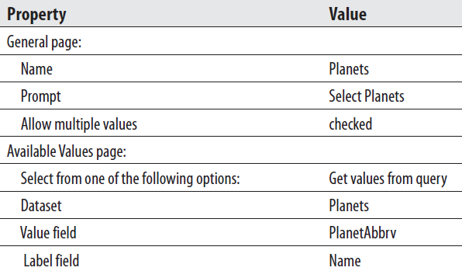
Exercise 5
Weather Report, Task 2: Create a Dataset, Add a Tablix to the Report Layout, and Populate It
Create a new data source called Galactic that references the Galactic shared data source.
Create a new dataset called Planets. Use the following for the query string:
SELECT Name, PlanetAbbrv FROM Planet ORDER BY Name
In the Report Data window, right-click the Parameters entry and select Add Parameter from the context menu. The Report Parameter Properties dialog box appears.
Set the properties of this new parameter as follows:

Slide 55
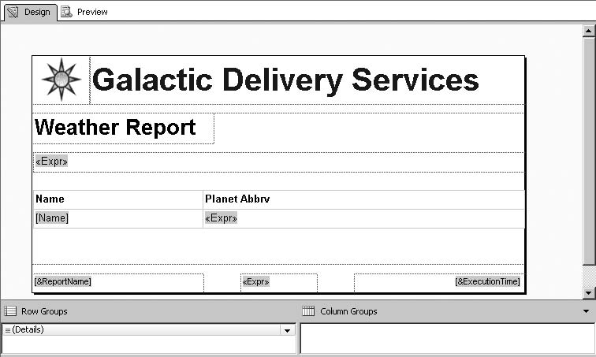
Exercise 5
Weather Report, Task 2: Create a Dataset, Add a Tablix to the Report Layout, and Populate It
Place two text boxes onto the body of the report. Then use the table template to place a tablix onto the body of the report. The expression in the second text box should be:
="Here is the current weather for the " & Parameters!Planets.Count &" planet(s) you selected"
Complete your report layout so it is similar to figure below. The expression in the right-hand detail cell should be:
=WeatherInfo.PlanetaryWeather.GetWeather(Fields!PlanetAbbrv.Value)

Slide 56
Exercise 5
Weather Report, Task 2: Create a Dataset, Add a Tablix to the Report Layout, and Populate It
Open the Tablix Properties dialog box. Select the Filters page.
Click Add.
Enter the following for Expression:
=Array.IndexOf(Parameters!Planets.Value, Fields!PlanetAbbrv.Value)
Select >= from the Operator drop-down list.
Enter the following expression for Value:
=0
Click OK to exit the Tablix Properties dialog box.
Click the Preview tab.
Use the Select Planets drop-down list to check Borlaron and Stilation. Click View Report.
Select Save All on the toolbar.

Slide 57
The Employee Evaluation Report
Features Highlighted
Using a subreport as reusable code
Creating a landscape report
Using a rectangle for grouping
Using rich formatting
Business Need - The Galactic Delivery Services personnel department has created an application for employees to conduct peer reviews as part of each employee’s annual review process. They are also collecting a review and comments from each employee’s manager. They need a report that can be used to present the results of the peer review at the employee’s meeting with their supervisor. The manager’s review and comments should be noted as coming from the manager. The peer reviews, however, should be presented anonymously.
Task Overview
Create a New Report, Create a Dataset, Add a Tablix to the Report Layout, and
Create a New Report, Create a Dataset, and Populate the Report Layout.
Add a Rectangle.
Add Rich Formatting.

Slide 58
Exercise 6
Employee Evaluation Report, Task 1: Create a New Report, Create a Dataset, Add a Tablix to the Report Layout, and Populate It
Reopen the Chapter09 project, if it was closed.
Create a new report called EvalDetail. Do not use the GDSReport template.
Create a new data source called Galactic that references the Galactic shared data source.
Create a new dataset called EvalRatings that calls the stp_EvalRatings stored procedure.
Use the table template to place a tablix onto the body of the report.
Select the Goal, Rating, and GoalComment fields in the data row of the table.
Add a parent row group to the table using grouping by EvaluatorEmployeeNumber. The group should have a group header and a group footer.

Slide 59
Exercise 6
Employee Evaluation Report, Task 1: Create a New Report, Create a Dataset, Add a Tablix to the Report Layout, and Populate It
Complete your report layout so it is similar to figure below. The top row has the BorderColor: Top property set to Black. The bottom row has the BorderColor: Bottom property set to Black and the BorderWidth: Bottom property set to 5pt. Also note that the table header row was deleted.
Select Save All on the toolbar.

Slide 60
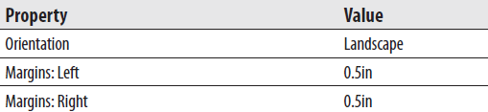

Exercise 6
Employee Evaluation Report, Task 2: Create a New Report, Create a Dataset, and Populate the Report Layout
Create a new report called EmployeeEval using the GDSReport template.
Create a new data source called Galactic that references the Galactic shared data source.
Create a new dataset called EvalPerformance that calls the stp_EvalPerformance stored procedure.
Open the Report Properties dialog box.
Modify the following properties of the report:
Click OK to exit the Report Properties dialog box.
Click the design surface to select the report body. Set the following property of the report body:

Slide 61
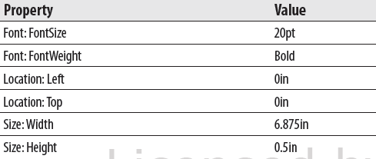
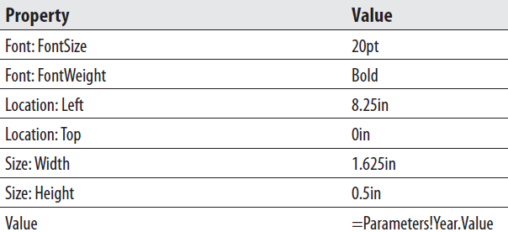
Exercise 6
Employee Evaluation Report, Task 2: Create a New Report, Create a Dataset, and Populate the Report Layout
Drag the EmployeeName field onto the report body. Modify the following properties of the text box that results:
Place a text box onto the report body. Modify the following properties of this text box:

Slide 62
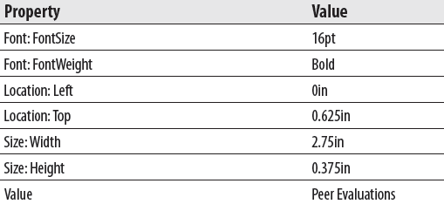
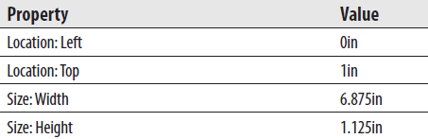
Exercise 6
Employee Evaluation Report, Task 2: Create a New Report, Create a Dataset, and Populate the Report Layout
Place a text box onto the report body. Modify the following properties of this text box:
Place a subreport onto the report body immediately below the text box. Modify the following properties of this subreport:
Right-click the subreport and select Subreport Properties from the context menu. The Subreport Properties dialog box appears.

Slide 63
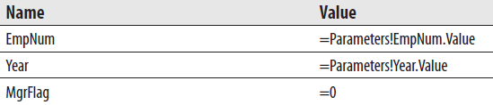
Exercise 6
Employee Evaluation Report, Task 2: Create a New Report, Create a Dataset, and Populate the Report Layout
Select EvalDetail from the Use this report as a subreport drop-down list.
Select the Parameters page.
Click Add to add parameters to the grid. Configure the parameters as shown here:
You can use the drop-down list to select the parameter names. You can use the Expression dialog box to select the parameter values.
Click OK to exit the Subreport Properties dialog box.
Select the Peer Evaluations text box and the subreport. Press ctrl-c to copy these two items. Press ctrl-v to paste a copy of these items on the report body. Drag the two copied items so they are immediately below the original subreport.
Modify the new text box to read “Manager Evaluation.” Adjust the width of the text box as needed.

Slide 64
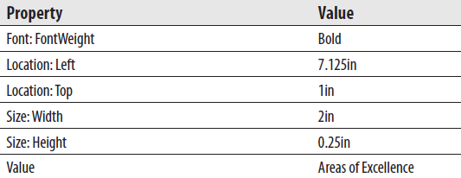
Exercise 6
Employee Evaluation Report, Task 2: Create a New Report, Create a Dataset, and Populate the Report Layout
Open the Subreport Properties dialog box for the new subreport and select the Parameters page.
Change the parameter value for MgrFlag from = 0 to = 1. This causes the second subreport to contain the manager’s evaluation rather than the peer evaluations.
Click OK to exit the Subreport Properties dialog box.
Place a text box onto the report body. Modify the following properties of this text box:

Slide 65
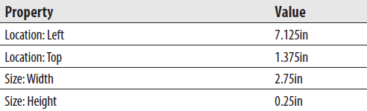
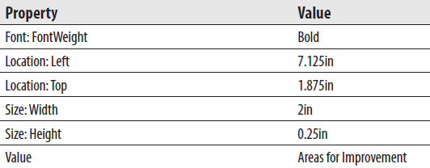
Exercise 6
Employee Evaluation Report, Task 2: Create a New Report, Create a Dataset, and Populate the Report Layout
Drag the AreasOfExcellence field onto the report body. Modify the following properties of the text box that results:
Place a text box onto the report body. Modify the following properties of this text box:

Slide 66
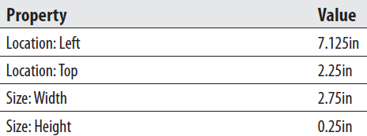
Exercise 6
Employee Evaluation Report, Task 2: Create a New Report, Create a Dataset, and Populate the Report Layout
Drag the AreasForImprovement field onto the report body. Modify the following properties of the text box that results:
Click the Preview tab. Enter 1394 for EmpNum and 2012 for Year, and then click View Report.

Slide 67
Exercise 6
Employee Evaluation Report, Task 3: Add a Rectangle
Click the Design tab.
Select the Areas of Excellence text box, the AreasOfExcellence field value text box, the Areas for Improvement text box, and the AreasForImprovement field value text box. Press ctrl-x to cut these four text boxes.
Select a rectangle from the Toolbox and place it in the area just vacated by these four text boxes.
With the rectangle still selected, press ctrl-v to paste the four text boxes into the rectangle.
Arrange the rectangle and the four text boxes as needed.
Click the Preview tab. Enter 1394 for EmpNum and 2012 for Year, and then click View Report.
Select Save All on the toolbar.

Slide 68
Exercise 6
Employee Evaluation Report, Task 4: Add Rich Formatting
Click the Design tab.
Double-click the text box containing the expression for the employee name (the large text box right below the Galactic Delivery Services logo and heading). sThe text edit cursor will be to the left of the “<<Expr>>” placeholder in the text box.
Type Employee:.
Highlight the text just entered in Step 3.
Click the bold button on the toolbar to unbold the selected text.
Select “12pt” from the font size drop-down list in the toolbar.
Double-click the text box containing the Year parameter. The text edit cursor will be to the left of the “[@Year]” placeholder.
Type Year: and press enter.
Highlight the text entered in Step 8.
Click the bold button on the toolbar to unbold the selected text.
Select “12pt” from the font size drop-down list in the toolbar.
Click outside of the Year parameter text box to unselect it. Single-click the Year parameter text box to select the text box.

Slide 69

Exercise 6
Employee Evaluation Report, Task 4: Add Rich Formatting
Modify the following property of this text box:
Double-click the text box for the AreasOfExcellence field.
Click “<<Expr>>” to highlight it.
Right-click the highlighted text and select Placeholder Properties from the context menu. The Placeholder Properties dialog box appears.
On the General page, select the HTML - Interpret HTML tags as styles radio button.
Click OK to exit the Placeholder Properties dialog box.
Repeat Step 14 through Step 18 for the AreasForImprovement field text box.
Click the Preview tab. Enter 1394 for EmpNum and 2012 for Year, and then click View Report.
Select Save All on the toolbar.

Slide 70
The Invoice Report
Features Highlighted
Using a subreport in a table
Using a subreport to facilitate drilldown
Using RenderFormat.Name
Exporting to PDF
Business Need - The Galactic Delivery Services accounting department wants an interactive Invoice Report. The Invoice Report needs to show the invoice header and invoice detail information. The user can then expand an invoice detail entry to view information on the delivery that created that invoice detail.
Task Overview
Create a New Report, Create a Dataset, and Copy the Layout from the DeliveryStatus Report.
Create a New Report, Create a Dataset, and Populate the Report Layout.
Improve PDF Export

Slide 71
Exercise 7
Invoice Report, Task 1: Create a New Report, Create a Dataset, and Copy the Layout from the DeliveryStatus Report
Reopen the Chapter09 project, if it was closed.
Create a new report called DeliveryDetail. Do not use the GDSReport template.
Create a new data source called Galactic that references the Galactic shared data source.
Create a new dataset called DeliveryStatus that calls the stp_DeliveryDetail stored procedure.
Double-click the entry for the DeliveryStatus report in the Solution Explorer to open this report.
Select the tablix in the DeliveryStatus report and press ctrl-c to copy it. (Make sure you have the entire tablix selected and not just a single cell in the tablix.)
Close the DeliveryStatus report and return to the DeliveryDetail report.
Press ctrl-v to paste the tablix into the report body.
Move the tablix to the upper-left corner of the report body. Size the report body so it exactly contains the table.
Save the report.

Slide 72
Exercise 7
Invoice Report, Task 2: Create a New Report, Create a Dataset, and Populate the Report Layout
Create a new report called Invoice using the GDSReport template.
Create a new data source called Galactic that references the Galactic shared data source.
Create a new dataset called InvoiceHeader that calls the stp_InvoiceHeader
stored procedure.
Create a second dataset called InvoiceDetail that calls the stp_InvoiceDetail stored procedure.
Use the list template to place a tablix onto the report body.
Size the tablix and add fields to create the layout (shown in next slide). The fields come from the InvoiceHeader dataset. The black line across the bottom is a solid bottom border on the tablix with a border width of 10 points.
Drag the report body to make it larger.
Use the table template to place a tablix onto the report body immediately below the existing tablix.

Slide 73

Exercise 7
Invoice Report, Task 2: Create a New Report, Create a Dataset, and Populate the Report Layout
Size the table columns appropriately. Type the letter C for the Format property of the text box containing the Amount field value.
Delete the table header row.
Select all three of the remaining cells in the tablix and set the following property:

Slide 74

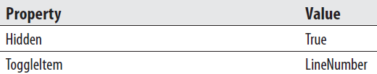
Exercise 7
Invoice Report, Task 2: Create a New Report, Create a Dataset, and Populate the Report Layout
Add a second details row below the existing data row. (In other words, insert a second row inside the details group.)
Merge the three cells in this new details row.
Place a subreport in the merged cell.
Open the Subreport Properties dialog box. Set the subreport to use the DeliveryDetail report.
Select the Parameters page and configure it as follows:
Click OK to exit the Subreport Parameters dialog box.
Click the gray box to the left of the row containing the subreport. Modify the following properties for this table row using the Properties window:
Click the Preview tab. Type 73054 for InvoiceNumber and click View Report.
Expand one of the invoice detail entries and observe how the subreport appears. Select Save All on the toolbar.

Slide 75
Exercise 7
Invoice Report, Task 3: Improve PDF Export
Click the Export drop-down button
Save the resulting PDF file, and open it with Adobe Reader. The PDF format does not support the drilldown activity, so we are not able to view the detail of any of the invoices. It would be helpful to have the invoice detail expanded when the report is exported to a PDF file.
Close Adobe Reader and delete the PDF file.
Back in the report authoring environment, return to Design mode.
Click anywhere in the table tablix on the report.
Click the gray box to the left of the row containing the subreport. Replace the value for the Hidden property with the following expression:
=IIF(Globals!RenderFormat.Name="PDF", False, True)
Right-click outside the report body but inside the layout area. Select Report Properties from the context menu. The Report Properties dialog box appears.
Preview/Run the report. Type 73054 for InvoiceNumber, and click View Report. The invoice detail is initially hidden when the report is viewed in the authoring environment.
Click the Export drop-down button, and select PDF from the drop-down menu.
Save the resulting PDF file, and open it with Adobe Reader. The invoice detail is not hidden when the rendering format is PDF.
Close Adobe Reader and delete the PDF file.
Save the report.

Slide 76
Interacting with Reports
In many cases, your reports can be much more effective when users can view them electronically. Reporting Services offers a number of options for enabling the user to interact with the reports when viewed in this way.
We have already seen several examples of drilldown interactivity. This type of interactivity hides detail information until it is needed by the user.
In this section, we will learn additional methods for navigating within reports and even moving between reports. We will also see how to link a report to Internet content.
Finally, we will look at a way for the report to interact with the user by always keeping its data current.

Slide 77
The Invoice Front-End Report
Features Highlighted
Using drill-through navigation to move between reports
Using the document map to navigate within a report
Using bookmarks to navigate within a report
Using links to navigate to Internet content
Using the page name property and built-in field
Exporting to Excel
Business Need - The Galactic Delivery Services accounting department is pleased with the Invoice Report. They would now like a front end to make the Invoice Report easier to use. The front-end report should list all invoices by customer and let the user click an invoice to see the complete Invoice Report. The front end should have each customer start on a new page. In addition, the front end should provide a quick way to navigate to the page for a particular customer, and a way to move from a customer to the page for its parent company. Finally, the front end should include a link to the customer’s website for further information on the customer.
Task Overview
Create a New Report, Create a Dataset, and Populate the Report Layout.
Add the Navigation.
Improve Excel Export

Slide 78
Exercise 8
Invoice Front-End Report, Task 1: Create a New Report, Create a Dataset, and Populate the Report Layout
Reopen the Chapter09 project, if it was closed.
Create a new report called FrontEnd using the GDSReport template.
Create a new data source called Galactic that references the Galactic shared data source.
Create a new dataset called CustomerInvoices that calls the stp_CustomerInvoices stored procedure.
Use the table template to place a tablix onto the report body.
Select the InvoiceNumber, InvoiceDate, and TotalAmount fields in the Data row of the table.
Type the letter C for the Format property for the text box containing the TotalAmount field value.
Delete the table header row.
Add a parent group to the table using the CustomerName as the group expression. The group should have a group header, but not a group footer. Use the Page Breaks page of the Group Properties dialog box to set a page break between each instance of a group.
Drag the cell containing the CustomerName field wide enough to contain the customer name without wrapping. Set the FontWeight property of this cell to Bold.
Merge the left and center cells in the group header row. Select the ParentName field in the newly merged cells.

Slide 79

Exercise 8
Invoice Front-End Report, Task 2: Add the Navigation
Right-click the cell containing the Invoice Number field and select Textbox: Text Box Properties from the context menu. The Text Box Properties dialog box appears.
Select the Action page.
Select the Go to report option under the Enable as a hyperlink prompt.
Select Invoice from the Select a report from the list drop-down list.
Click Add in the parameters area and configure the parameter as follows:
Click OK to exit the Text Box Properties dialog box.
In the Row Groups pane, use the Group1 drop-down menu to select Group Properties. The Group Properties dialog box appears.
Select the Advanced page.
Select [CustomerName] from the Document map drop-down list.
Click OK to exit the Group Properties dialog box.
Select the cell containing the CustomerName field. Set the following property in the Properties window:

Slide 80
Exercise 8
Invoice Front-End Report, Task 2: Add the Navigation
Right-click the cell containing the ParentName field and select Textbox: Text Box Properties from the context menu. The Text Box Properties dialog box appears.
Select the Action page.
Select the Go to bookmark option under the Enable as a hyperlink prompt.
Select [ParentName] from the Select bookmark drop-down list.
Click OK to exit the Text Box Properties dialog box.
Right-click the rightmost cell in the group header row and select Textbox: Text box Properties from the context menu. The Text Box Properties dialog box appears.
Type Website Link for Value.
Select the Action page.
Select the Go to URL option under the Enable as a hyperlink prompt.
Select [CustomerWebsite] from the Select URL drop-down list.
Click OK to exit the Text Box Properties dialog box.
Click the Preview tab.
Select Save All on the toolbar.

Slide 81
Exercise 8
Invoice Front-End Report, Task 3: ImproveExcel Export
Click the Export drop-down button. Select Excel from the drop-down menu.
Save the resulting Excel workbook file and open it in Excel 2007 or Excel 2010. Each page of the report appears as a separate spreadsheet tab. The first spreadsheet functions as the document map and the name on the tab says “Document map.” The other tabs have generic names: Sheet2, Sheet3, and so on. What would make this even better is to have each tab show the name of the customer whose information it displays.
Close Excel and delete the workbook file.
Back in the report authoring environment, return to Design mode.
Click the CustomerName item in the Row Groups area to select it. The Properties window says “Tablix Member” at the top.
Set the following property:
This will name each page after the Customer Name.
Right-click the text box containing “[&ReportName]” in the lower-left corner of the report, and select Expression from the context menu. The Expression dialog box appears.

Slide 82
Exercise 8
Invoice Front-End Report, Task 3: ImproveExcel Export
Add to the expression in the Set expression for: Value so it matches the following:
=Globals!ReportName & "-" & Globals!PageName
Click OK to exit the Expression dialog box.
Preview the report.
Page through the report and note the page name is now shown with the report name in the report footer.
Export the report to Excel and save the worksheet file as you did before.
Open the Excel workbook file. Note the names on the tabs now reflect the value of the PageName property.
Close Excel and delete the worksheet file.
Save the report.

Slide 83
The Transport Monitor Report
Features Highlighted
Using a chart as the data section of a tablix
Indicating values over a set maximum on a chart
Using the autorefresh report property
Using a multivalued parameter with a WHERE clause
Business Need - The Galactic Delivery Services maintenance department needs a report to assist in monitoring transport operations. Each transport feeds real-time sensor data back to the central database. The maintenance department needs a report to display this information for a selected set of transports. Because the sensor data is updated every minute, the report should refresh every minute. The sensor data should be displayed in a graphical form, with a highlight of any values that are above the normal maximums.
Task Overview
Create a New Report, Create a Dataset, Populate the Report Layout, and Set Report Properties.

Slide 84
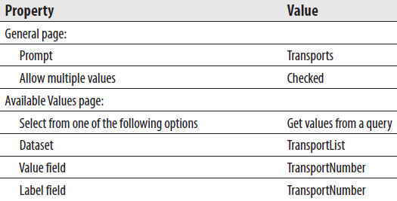
Exercise 9
Transport Monitor Report, Task 1: Create a New Report, Create a Dataset, Populate the Report Layout, and Set Report Properties
Reopen the Chapter09 project, if it was closed.
Create a new report called TransportMonitor. Do not use the GDSReport template.
Create a new data source called Galactic that references the Galactic shared data source.
Create a new dataset called TransportMonitor that calls the stp_TransportMonitor stored procedure.
Create a second dataset called TransportList that calls the stp_TransportList stored procedure.
Configure the TransportNumber Report Parameter as follows:
Click OK to exit the Report Parameter Properties dialog box.

Slide 85
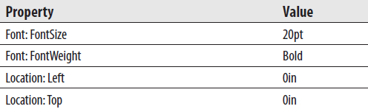


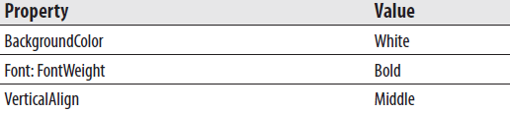
Exercise 9
Transport Monitor Report, Task 1: Create a New Report, Create a Dataset, Populate the Report Layout, and Set Report Properties
Place a text box on the report body and set its properties as follows:
Use the matrix template to place a tablix onto the report body. Set the properties of the tablix as follows:
Select the TransportNumber field from the TransportMonitor dataset in the Rows cell. Set the following properties of the text box created in that cell:

Slide 86
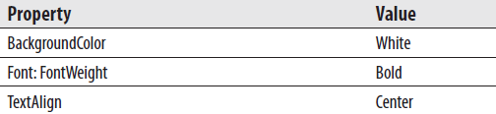


Exercise 9
Transport Monitor Report, Task 1: Create a New Report, Create a Dataset, Populate the Report Layout, and Set Report Properties
Select the Item field in the Columns cell. Set the following properties of the text box created in that cell:
Open the Tablix Properties dialog box. Set the following properties:
Click OK to exit the Tablix Properties dialog box.
Select the Data cell of the tablix and set the following property:
Place a chart in the Data cell. The Select Chart Type dialog box appears.
Select the stacked column chart and click OK.

Slide 87


Exercise 9
Transport Monitor Report, Task 1: Create a New Report, Create a Dataset, Populate the Report Layout, and Set Report Properties
Click the chart to activate the drop areas. Select the Value field in the Drop data fields here area.
Use the green plus sign next to the Category Groups area to select the Reading field. Use the green plus sign next to the Series Groups area to select the ReadingPortion field.
In the Chart Properties dialog box, set the following property:
In the Value Axis Properties dialog box, set the following property:
Right-click the chart title and select Delete Title from the context menu.
Right-click the legend area of the chart and select Delete Legend from the context menu.
Right-click the vertical axis title and select Show Axis Title from the context menu. This will uncheck this option and hide the axis title.
Right-click the value axis title and select Show Axis Title from the context menu. This will uncheck this option and hide the axis title.

Slide 88

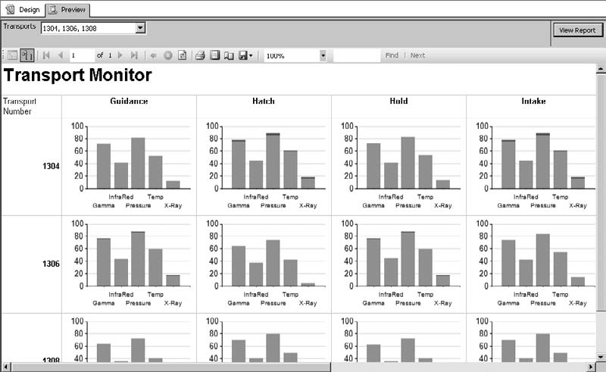
Exercise 9
Transport Monitor Report, Task 1: Create a New Report, Create a Dataset, Populate the Report Layout, and Set Report Properties
Click anywhere outside the report body to bring up the report properties in the Properties window. Set the following property in the Properties window:
Click the Preview tab.
Select several transport numbers from the drop-down list and click View Report. Your report appears similar to figure below.
Select Save All on the toolbar.

